Slide 1

Music Store Sales Analysis

Slide 2

Index
Introduction
Objectives
Overview
Business Questions
Business Insights
Recommendations
Conclusion

Slide 3

Introduction
Analyzing Music Sales Performance , A Deep Dive into Music Sales Data , This presentation provides a comprehensive analysis of our music sales data, focusing on key metrics such as revenue, genre popularity, artist performance, and customer behavior. By examining these trends, we can gain valuable insights into our market position and identify opportunities for growth.
Overall Sales Performance: Total revenue generated by top countries , Revenue distribution among top cities ,Year-over-year sales trends.
Genre Analysis: Most popular genre in each country Top-selling genres overall.
Artist Analysis: Top-selling artists ,Artist sales performance by genre.
Customer Analysis: Top customers by total spending , Customer behavior patterns.
This introduction sets the stage for the presentation by outlining the key areas of focus and providing an overview of the insights that will be shared.

Slide 4
Objectives
The primary objectives of this analysis are to:
Understand Market Dynamics: Identify the most popular music genres and artists in different countries. Analyze sales trends over time to identify growth opportunities and potential challenges. Understand the factors driving customer purchasing behavior.
2. Optimize Business Strategies: Make informed decisions about inventory management, marketing efforts, and product recommendations. Identify areas for expansion or diversification based on sales data. Optimize pricing strategies to maximize revenue.
3. Enhance Customer Experience: Tailor product recommendations and promotions to individual customer preferences. Improve customer satisfaction by addressing any identified pain points. By achieving these objectives, we can gain valuable insights into the music market, optimize business operations, and ultimately improve customer satisfaction and revenue.

Slide 5
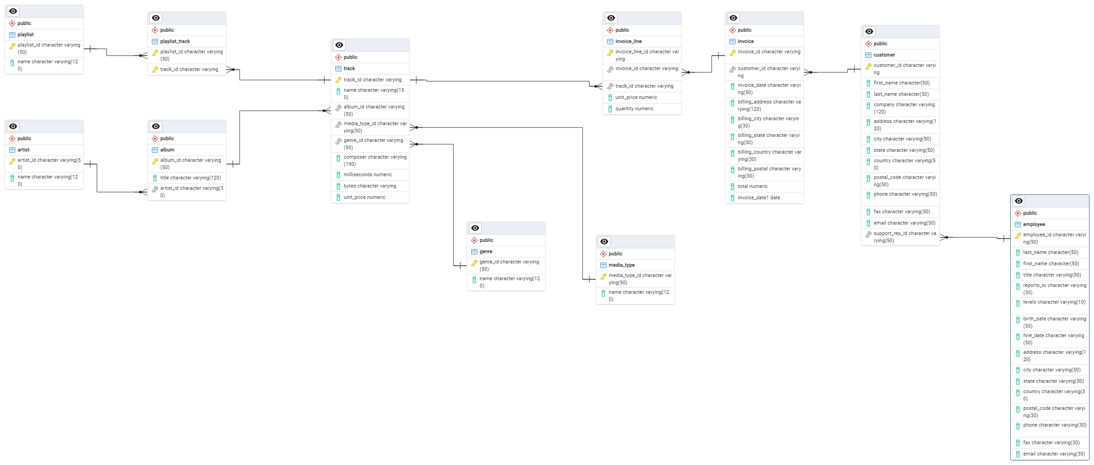
Overview
The provided database schema consists of 11 tables, each representing a different aspect of a music store's operations:
Core Entities:
Album: Stores information about albums, including their title and artist.
Artist: Stores information about artists, including their names.
Customer: Stores customer details, including contact information and purchase history.
Employee: Stores employee information, including roles and contact details.
Genre: Stores information about music genres.
Track: Stores information about individual tracks, including their name, album, genre, and pricing.
Relationships:
Invoice: Represents sales transactions, linking customers to purchased items.
InvoiceLine: Details the specific tracks purchased in each invoice.
Playlist: Stores information about playlists created by customers.
PlaylistTrack: Links playlists to specific tracks.
Media type: Stores information about different media types (e.g., CD, MP3).

Slide 6
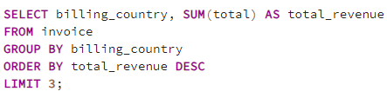
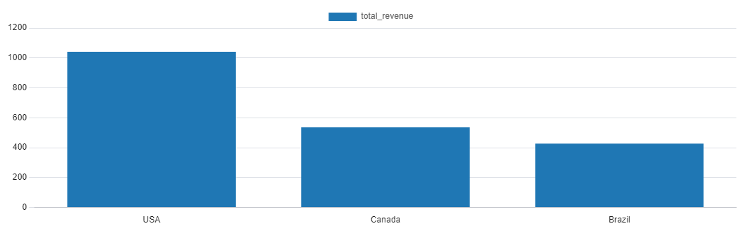
Total sales revenue generated by top 3 countries
This bar chart illustrates the total revenue generated by the top 3 countries: the United States, Canada and Brazil.
The United States stands out as the clear leader, generating significantly more revenue than the other two countries.
Canada and Brazil follow, with a noticeable gap between them..
These results highlight the dominance of the United States in the market and the potential for growth in Canada and Brazil.

Slide 7
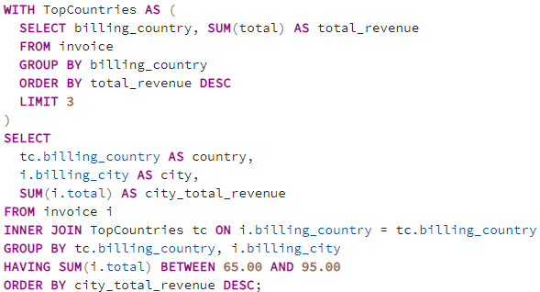
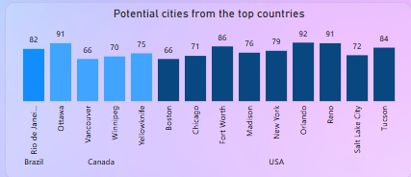
Cities have the most revenue from top country
Growth Opportunities in Mid-Tier Cities
This bar chart illustrates the distribution of total sales for cities within the top country, focusing on the range of $65.00 to $95.00.
Several cities within this revenue range demonstrate potential for further growth, as they are not significantly outperforming the top cities but still hold a substantial market share.
Cities like Ottawa, Reno, Tucson, Porto, and Stuttgart stand out as promising candidates for increased investment and targeted marketing efforts.

Slide 8
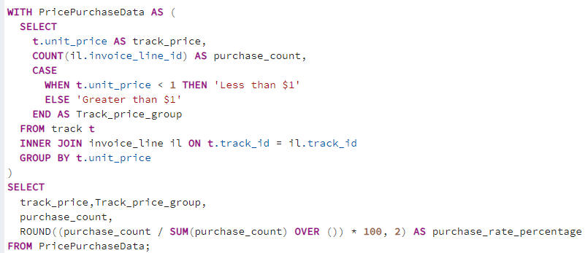
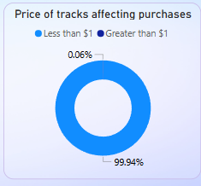
Price of tracks affecting the purchase rate
Impact of Track Price on Purchase Rate:
This pie chart illustrates the distribution of purchases across different track price points.
The vast majority (99.94%) of purchases are for tracks priced at Less than $1, indicating a strong preference for lower-priced options.
Only 0.06% of purchases are for tracks priced at Greater than $1, suggesting a limited market for higher-priced tracks.

Slide 9
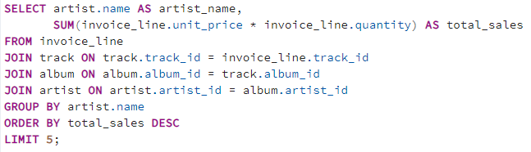
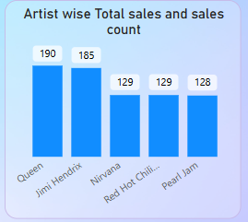
Artist wise sum of sales and count of sales
Top-Selling Artists: Sales and Count Comparison:
This dual-axis chart illustrates a comparison of total sales and sales count for the top-selling artists.
Queen leads in both total sales and sales count, demonstrating consistent popularity and sales volume.
Jimi Hendrix and Nirvana follow closely in terms of total sales, while Queen and Jimi Hendrix also have a significant number of sales.
Red Hot Chili Peppers and Pearl Jam show a balance between total sales and sales count, indicating a dedicated fan base with higher average sales per purchase.

Slide 10
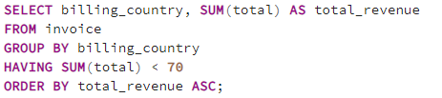
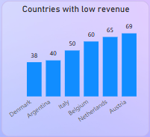
Countries has the low sales revenue
Analyzing the Chart: Countries with Low Revenue:
Countries with Revenue Below $70
This bar chart illustrates the distribution of total revenue for countries that have not reached the $70 sales threshold.
Denmark, Argentina, and Italy are the countries with the lowest revenue, all falling below the $70 mark.
Belgium, Netherlands, and Austria demonstrate slightly higher revenue levels but still remain below the $70 threshold.

Slide 11
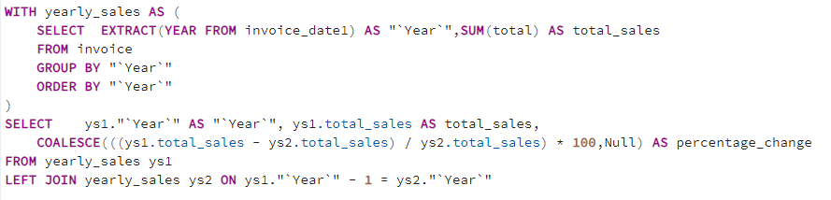
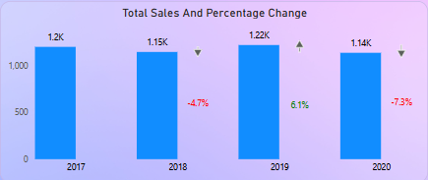
Year wise sales and Percentage change
Sales Performance Over Time:
This line chart illustrates the year-over-year trend in total sales from 2017 to 2020.
Sales experienced a steady increase from 2017 to 2019, peaking in 2019."
A significant decline occurred in 2020, potentially due to external factors such as the COVID-19 pandemic.
The percentage change graph highlights the fluctuations in growth rate, with a notable drop in 2020.

Slide 12
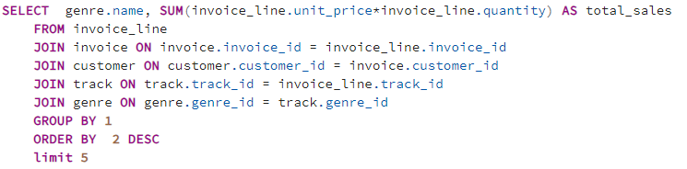
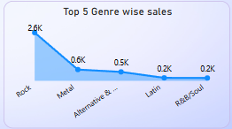
Top 5 genre wise sales
This bar chart illustrates the top 5 music genres based on total sales. Where it indicates Dominance of Rock Music.
Rock music reigns supreme, outselling all other genres by a significant margin.
Metal and Alternative & follow closely behind, indicating a strong demand for these genres.
Latin and R&B/Soul occupy the lower ranks, suggesting niche preferences or regional variations.

Slide 13
Business Insights
Based on the provided charts and data, here are some key business insights:
Rock Dominance: Rock music is the most popular genre across the analyzed countries, indicating a strong market demand.
Niche Markets: While rock dominates, genres like Alternative and Latin have a niche following in certain regions, suggesting potential opportunities for targeting specific audiences.
Artist Performance
Queen's Leadership: Queen consistently ranks as a top-selling artist, demonstrating their broad appeal and strong fan base.
Diverse Success Factors: Different artists excel in different areas. Some have high total sales, while others have a large number of individual sales, indicating varying levels of fan engagement.
Customer Behavior
Repeat Purchases: Analyze customer purchase history to identify repeat buyers and their preferences. This can help tailor marketing efforts and product recommendations.
Regional Variations: Consider regional differences in customer preferences and tailor marketing strategies accordingly.
Sales Trends
Year-over-Year Analysis: Evaluate sales trends over time to identify growth patterns, seasonal fluctuations, and potential impacts of external factors.
Identify Peak Sales Periods: Determine the most profitable times of the year and plan marketing campaigns accordingly.
Country-Specific Insights
Top-Performing Countries: Analyze the top-performing countries and identify factors contributing to their success.
Growth Opportunities: Explore untapped markets or regions with lower sales potential.

Slide 14
Recommendations
Optimize Product Mix: Focus on promoting popular genres and artists while exploring niche markets.
Tailor Marketing Efforts:
Identify high-value customers using the "Loyalty Card" status and purchase history.
Develop targeted marketing campaigns to increase retention and encourage repeat purchases.
Target specific customer segments based on their preferences and purchasing behavior.
Let's investigate the factors contributing to the lower revenue in these countries and explore strategies to boost sales and increase market penetration.
Improve Customer Experience: Provide personalized recommendations and offers to enhance customer satisfaction.
Identify Growth Opportunities: Explore new markets or expand into underperforming regions.
Consider adjusting pricing strategies to capitalize on the demand for lower-priced tracks while exploring opportunities to increase sales for higher-priced tracks, perhaps by offering bundled deals or exclusive content.

Slide 15
Conclusions
Number of employees are less at senior level as compared to junior level.
Maximum customers belongs from Europe only( ~70%).
Maximum total invoice amount is from Prague city also top two customers in terms of money they spend also belongs to this city only.
Rock is the only music genre which is popular in all country except Argentina in terms of purchase and Popularity wise.
Led Zeppelin tops the list of Artists who have written the most Rock Music with 114 songs
The top customer who stands out in spending the most on music is from Czech Republic.

Slide 16

THANK YOU

